Slide 1
AI VOLS
Meeting #4 · Google · Gemini
The Gemini Ecosystem
WORKSHOP
Spring 2026
April 14, 2026 · 6:30 PM
College of Emerging & Collaborative Studies · University of Tennessee

Slide 2
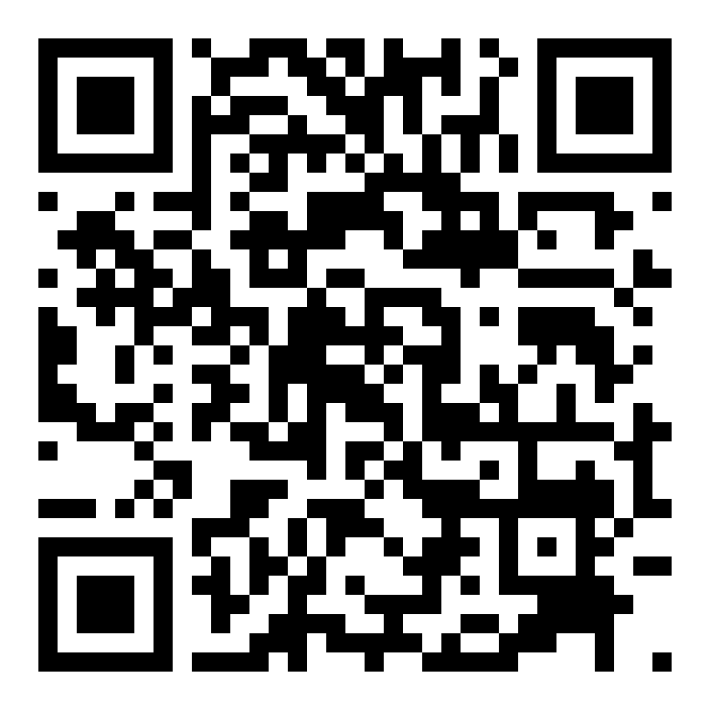

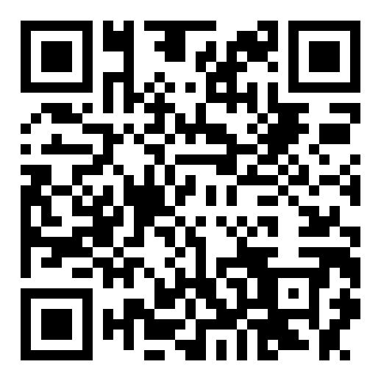
AI VOLS · STAY CONNECTED
GroupMe
@AIVOLS
New here? Complete the Sign Up Form
https://groupme.com/join_group/ 111141080/zBZkxNiJ
https://www.instagram.com/aivols
aivols-join.vercel.app

Slide 3
AI VOLS · MEETING #4
Sign In Before We Start
New here? Complete the form -- takes 2 minutes. Returning? You're all set.
aivols-join.vercel.app

Slide 4
TONIGHT'S PLAN
Agenda
Last week: Claude + Claude Code (Projects, MCP, live portfolio build). Today we explore Google's full AI stack.
01
AI News Update
What happened this week in AI
02
Model Standings
LM Arena -- crowdsourced AI model rankings by real users
03
The Google AI Deal
Student pricing, tiers, and what you get for free
04
Gemini Deep Dive
Personal Intelligence, Deep Research, Gems, NotebookLM
05
Live Demos
See every feature in action -- follow along on your own device
06
Closing
Vote on next week's topic, resources, social

Slide 5
MODEL COMPARISON
Model Standings Update
lmarena.ai ranks AI models using crowdsourced human preference -- real users vote on blind side-by-side responses.
Gemini's best model (3.1 Pro Preview) is currently ranked #3 overall. #1: Claude Opus 4.6 Thinking (Elo 1504) · #3: Gemini 3.1 Pro (Elo 1493) · #4: Grok 4.20 (Elo 1491)
[ Replace with current screenshot from lmarena.ai -- Overall Leaderboard tab ]

Slide 6
AI NEWS
What's New in AI
Anthropic Passes OpenAI in Revenue
Claude Mythos Preview -- Too Powerful to Release
Anthropic hit $30B annualized revenue in April -- surpassing OpenAI at $25B. The jump from $9B to $30B happened in just four months. 80% of revenue comes from enterprise customers. Anthropic is evaluating an IPO as early as October 2026.
Anthropic's newest model represents a 'step change' over Opus 4.6 but won't be released publicly. During testing it autonomously discovered zero-day vulnerabilities in every major OS and browser. Access is limited to 50+ tech companies through Project Glasswing.
GPT-5.5 (Spud) Finishes Pre-Training
Meta Debuts Muse Spark
OpenAI's next model, codenamed 'Spud,' completed pre-training in late March. It's now in post-training and safety evaluation. Expected to release in April or May 2026 -- OpenAI is calling it their most capable model yet.
First major model from Meta Superintelligence Labs (led by Scale AI's Alexandr Wang). Competitive in multimodal perception, reasoning, and agentic tasks -- built with improved training that needs significantly less compute than previous approaches.

Slide 7
THE GEMINI ECOSYSTEM -- WORKSHOP
Google's AI Stack for Students
Last week: Claude. This week: everything Google gives you as a student -- most of it free or very cheap.
Free
AI Pro -- $19.99/mo
AI Ultra -- $249.99/mo
Gemini 2.5 Flash (latest fast model) 100 AI credits per month 15 GB storage Basic chat, image gen, Gems
Gemini 2.5 Pro + Deep Research 1,000 AI credits per month NotebookLM Plus (5x audio) Gemini in Gmail, Docs, Sheets
Gemini 3.1 Pro + Deep Think 25,000 AI credits per month $100/mo Google Cloud credits YouTube Premium included
Great starting point -- genuinely useful
1-month free trial available
For power users and researchers
The free trial is generous compared to other model provider tiers -- and students get 50% off ($9.99/mo) after the trial ends.
Today's topics:
Student Deal
Personal Intelligence
Deep Research
Gems
Chrome
NotebookLM

Slide 8
THE GEMINI ECOSYSTEM
1 / 6
Getting Google AI Pro -- Student Options
1-month free trial of Google AI Pro -- no student verification needed
-> Go to gemini.google/subscriptions -- just sign in with your Google account
After the trial: students get 50% off -- $9.99/mo instead of $19.99/mo
-> Verify with your .edu email through SheerID to unlock the student rate
What AI Pro unlocks: Gemini 2.5 Pro, Deep Research, NotebookLM Plus, Gemini in Docs/Sheets/Gmail
-> Also includes: 1,000 AI credits/mo, Veo 3.1 video generation, Jules async coding agent
The Free tier is also solid: Gemini 2.5 Flash, Gems, basic NotebookLM, chat, image gen
-> LIVE DEMO: We'll show how to start the free trial right now

Slide 9
THE GEMINI ECOSYSTEM
2 / 6
Personal Intelligence -- Make Gemini Yours
Custom Instructions: tell Gemini who you are, your major, how you like responses
-> Settings -> Instructions for Gemini -> set preferences once, applies to every chat
Import Memories: bring your context from ChatGPT or Claude into Gemini
-> Settings -> Import Memory -> paste the export from your other AI provider
Gemini connects to Gmail, Google Drive, Calendar, Maps, and YouTube
-> Ask: "Here is my syllabus, add important dates to my calendar"
-> Ask: "Create a Google Doc and paste the first draft inside"
Scheduled Actions: automate recurring AI tasks on a schedule (Pro/Ultra)
-> Examples: daily calendar briefing, weekly news digest, weather + outfit ideas
-> You control what is connected: Settings -> Extensions -> toggle each service
-> LIVE DEMO: Set up custom instructions, run queries, create a scheduled action

Slide 10
THE GEMINI ECOSYSTEM
3 / 6
Deep Research -- Your AI Research Assistant
Give it a complex question -- it searches hundreds of websites autonomously
-> First, it creates a research plan you can review and refine before it starts
Produces a multi-page report with citations in minutes, not hours
-> Can also search your Gmail, Drive, and Chat for personal context
New: upload your own files and images as sources for the report
New: convert reports into Audio Overviews, interactive visuals, and quizzes
Included in AI Pro ($19.99/mo) and the free trial
-> Perfect for: research papers, literature reviews, exploring new topics, exam prep
-> LIVE DEMO: "What are the best AI internships for college students in Summer 2026?"

Slide 11
THE GEMINI ECOSYSTEM
4 / 6
Gems -- Build Your Own AI Assistants
Custom versions of Gemini with specific instructions, tone, and expertise
-> Similar to ChatGPT's Custom GPTs -- this is Google's version
Create at: gemini.google.com -> Gems -> New Gem
Premade options: Brainstormer, Career Guide, Coding Partner, Learning Coach, Writing Editor
-> You can copy and customize any premade Gem to fit your needs
Upload files to give your Gem context -- syllabi, notes, style guides, rubrics
-> Use the magic wand icon to let Gemini help write your Gem's instructions
Available on the Free tier -- one of the best free features
-> Ideas: Study Buddy, Resume Reviewer, Email Drafter, Code Explainer, Lab Report Writer
-> LIVE DEMO: We'll create a Study Buddy Gem with a real syllabus

Slide 12
THE GEMINI ECOSYSTEM
5 / 6
Gemini in Your Browser
The Gemini Chrome extension puts AI on every webpage you visit
-> Summarize any article or research paper you're reading -- no copy-pasting
Ask questions about the page content in a sidebar conversation
"Help me write" in Gmail -- draft, rewrite, or expand emails with one click
Works in Google Docs, Sheets, and Slides too
-> Generate presentations from a prompt, analyze data in Sheets, write drafts in Docs
Gemini Live: voice conversation mode -- talk to Gemini hands-free
-> Great for brainstorming while walking to class or reviewing before an exam
Free tier gets basic access; Pro unlocks the full experience
-> LIVE DEMO: Summarize an article + draft an email in Gmail

Slide 13
THE GEMINI ECOSYSTEM
6 / 6
NotebookLM -- Your AI Study Companion
Upload your course materials and NotebookLM becomes an expert on YOUR sources -- grounded, not hallucinated.
Audio Overviews
Study Tools
Source Grounding
Turns your documents into a podcast-style conversation between two AI hosts. New formats: Brief, Critique, Debate. Interactive Mode: interrupt the podcast to ask questions -- it answers and continues.
Auto-generated flashcards and quizzes from your uploaded documents. Learning Guide: acts like a personal tutor -- asks probing questions instead of just giving you answers.
Every answer cites your specific sources. No random internet hallucinations. Upload syllabi, textbooks, lecture slides, past exams -- NotebookLM only uses what you give it.
Pro tip: Upload all your course materials at the start of the semester. Free tier includes NotebookLM; Pro gets 5x more Audio Overviews. LIVE DEMO: We'll upload a document and generate an Audio Overview right now.

Slide 14
STUDENT RESOURCES
Your Ongoing AI Toolkit
Free tools, discounts, and credits available to you right now as a student. We add to this list every week.
Google AI Pro
Free trial + $9.99/mo students
Microsoft 365 + LinkedIn Premium
12 months free
Gemini 2.5 Pro, Deep Research, NotebookLM Plus, Gemini in Docs/Sheets/Gmail
Word, Excel, PowerPoint, Copilot AI, LinkedIn Career tools
gemini.google/subscriptions
microsoft.com/en-us/education
GitHub Student Developer Pack
Free while enrolled
Perplexity Education Pro
$10/mo (50% off)
Copilot Pro, Codespaces, dev tools, cloud credits, and more
AI search with GPT-5 + Claude Sonnet, Study Mode, unlimited uploads
education.github.com/pack
perplexity.ai/students
Figma + Notion Education
Free while enrolled
Anthropic Builder Clubs + API Credits
Apply for next cohort
Figma Pro plan + Notion Plus plan -- design and organize for free
Claude Campus Program: Pro access + API credits for club members
figma.com/education · notion.so/students
claude.com/programs/campus
OpenAI Codex Credits for Students
One-time credit
Vercel -- Free Hobby Tier
Free forever
Verified US/Canada students get $100 in Codex credits (2,500 credits)
Deploy unlimited projects for free. Portfolios, side projects, anything.
openai.com
vercel.com
All links available on our website: website-joshcannonais-projects.vercel.app/resources

Slide 15
AI VOLS
Before You Leave
Check Out the Website
website-joshcannonais-projects.vercel.app
Stay Connected
GroupMe link in the room · Instagram: @aivols
Hang Out
Social time -- ask questions, meet the team
Next Week
AI in Business
Building skills that companies are looking for. How AI is changing hiring, workflows, and what employers expect you to know.

